Slide 1
Sales Dashboard Summary
Interactive Dashboard for Business Insights
By Vellon Moraes

Slide 2
Dataset Overview
Dataset Name: Sample – Superstore
Source: https://www.kaggle.com/datasets/vivek468/superstore-dataset-final
Total Records: 9994
Fields Used: SALES, ORDERDATE, PRODUCTLINE, COUNTRY
Tool: Tableau

Slide 3
Objectives & KPIs
Objective: Design a dashboard to help business stakeholders track sales performance
KPIs:
Total Sales
Total Orders
Total Profit (Calculated)
Top Products / Countries
Sales Trend Over Time

Slide 4
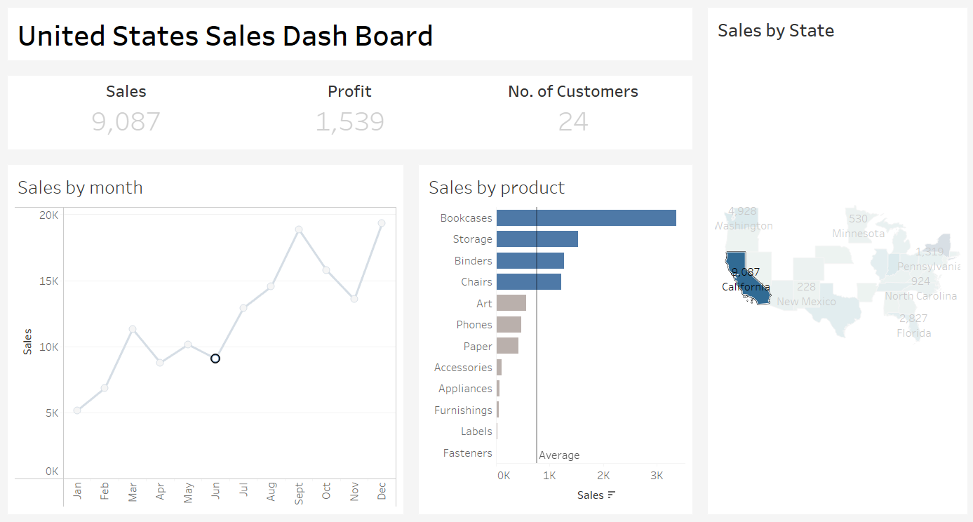
Dashboard Overview
Dashboard includes interactive slicers for Year, Product Line, and Country

Slide 5
Key Visuals & Interactions
Sales trend over time (line chart)
Product-wise sales (bar chart)
Geographic performance (map)
Profitability analysis
Slicers for interactivity

Slide 6
Conclusion
This interactive sales dashboard provides a comprehensive view of key performance metrics including sales, profit, and regional performance.
Through visual insights and dynamic filters, stakeholders can identify trends, monitor growth, and make data-driven decisions.
The dashboard empowers decision-makers to:
Track sales performance over time
Identify top-performing products and regions
Understand market dynamics and customer segments
This dashboard bridges raw data and business insight, helping stakeholders turn analysis into action.

Slide 7
Thank you

